Slide 1
Panel Discussion on Interdisciplinary Team Teaching
Dr. Lynn Bradley
May 10, 2012

Slide 2
The Dynamic Duo
Lynn Bradley (Chemistry)
Elizabeth Mackie (Art)
FSP 141 – Chemistry of Art, Art of Chemistry (Fall 2010)
FSP 141 – Photography, Metals and Dyes: The Chemistry of Creating Art (Fall 2011)

Slide 3
Idea for the Course
NSF Workshop June 2009 (1 week), Millersville University
“Chemistry in Art”
Both attended
Focus on art history and chemical topics
Challenge: writing-intensive and integrate chemistry with fine arts
Spent a year developing the course

Slide 4
Year 1 – Fall 2010
Shared a single section
4 overall topics covered
5 lab activities
Several assessments
Need for Improvement:
Too many assessments
Not enough in-class writing, additional help required
Final project needed revision
More integrated approach
Hands-on activities key
Lack of literature

Slide 5
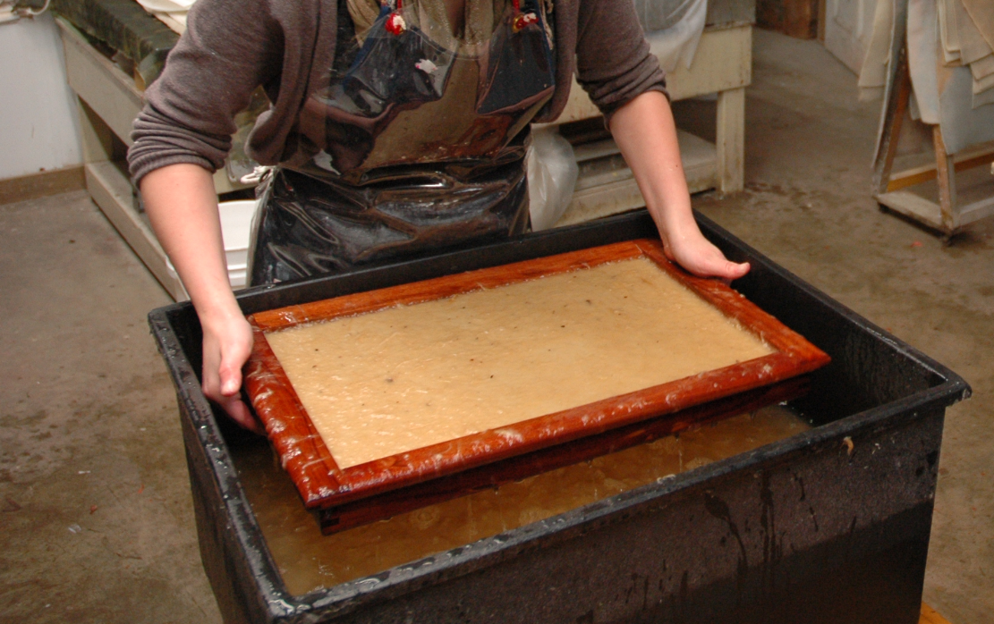
Paper Making
Attracted a variety of students
Awareness of how chemistry and art relate
Excitement and personal experience to the course
Learned from each other

Slide 6
Patina on Copper

Slide 7
Patina on Copper

Slide 8
FSP 141 – Fall 2010: Fiber Reactive Dyes

Slide 9
Year 2 – Fall 2011
Each had our own section
4 to 3 topics
3 hands-on activities
Added field trip to NY
Change in assessments (portfolios)
ARTStor and peer tutors added (Diane)
Objectives and assignments more clearly defined

Slide 10
Indigo Dyeing and Fiber Reactive Dyes

Slide 11
Indigo and Fiber Reactive Dyes

Slide 12
Lessons Learned
Students need help with writing
Teach chemistry and art in context of topics
Less is more
Hands-on activities crucial to success
Time-intensive for instructors
Ideas to generate discussion

Slide 13
Benefits of the Interdisciplinary Approach
Attracted a variety of students
Awareness of how chemistry and art relate
Excitement and personal experience to the course
Learned from each other
Students understand the value of other disciplines

Slide 14
Future of the Course
Exploring London Through the Eyes of Art and Chemistry
Summer 2013
AFA 203 – approved for Literary, Visual, and Performing Arts and Global
CHE 103 – approved for Natural Science and Global
Museums, field trips (Frogmore Mill, Henry Fox Talbot), sculpture gardens
Expanded art projects including a final “Map of London”

